Slide 1
Selling Kofax Cloud
Richard Haine
Snr. Enablement Programs Manager
Kofax

Slide 2

What is
Cloud?
Compute services over the Internet
Notes:
Delivery of computing services over the internet:
Virtual Machines
Storage
Database
Networking
Internet of Things
Machine Learning
Artificial Intelligence
Physical Infrastructure is owned/managed by the Cloud Providers not the Client
Capacity or services are typically billed annually (subscription) or using PAYG
Most vendors offer “free” tier or trial access

Slide 3
Why
Cloud?
Scalability
Reliability
Sustainability
Accessibility
Flexibility
Security
Notes:
Across All Industries
Scalable & reliable – elastic infrastructure
Cloud – someone else manages the data centre
Key is compute & storage
Because cloud computing uses the internet to deliver these services, it doesn’t have to be constrained by physical infrastructure the same way that a traditional datacenter is.
More flexible licensing – Subscription & PayAsYouGo / Consumption Based
Opex over Capex
Remote working
Lower TCO (??) admins
Always on the latest versions of the tech
Specialise in your own business not IT – fewer in house skills / admin needed
Following a report by BCG, companies can save 15-40% on infrastructure costs by migrating to the cloud

Slide 4
Why
Cloud?
95%
Notes:
Over 95% of businesses will use cloud computing by 2025

Slide 5
“Cloud adoption will continue to grow at a compound annual growth rate (CAGR) of 16.3% between 2021 and 2026.”
Markets & Markets
Notes:
over 95% of businesses will use cloud computing by 2025. T

Slide 6


Cloud Delivery
Model
SaaS
PaaS
On Premise
IaaS
Notes:
For those of you that have already watched the webinars I delivered on Kofax Cloud, this will be familiar to you. It shows the different Cloud delivery models available.
On the right hand side, Software as a Service, Platform as a Service and Infrastructure as a Service models that customers can consume from 3rd parties on an as-needed basis to deliver what their business needs. The differences between these are in what the customer takes responsibility for, I’ll cover that in more detail in a minute but SaaS has the least customer responsibility and often provides the least flexibility for customisations whereas Infrastructure as a Service has the customer taking on responsibility for maintaining much of the software whilst the vendor manages the Physical infrastructure that the software is deployed to.
Some of you may be thinking that On Premise is not Cloud…
Actually, Cloud can be On Premise.. I know that sounds odd right..
depending on the technology used, your customers may have a private cloud or hybrid cloud environment that has components On-Premise in their own or shared Datacentres. This is often used where data residency challenges prevent the content from being held outside the country. Countries such as Luxembourg have strict data residency regulations that may force customers to adopt the hybrid model.
More commonly though, customers are leveraging cloud providers such as Amazon Web Services, Azure, Google Cloud etc. to provide the service they require.

Slide 7

SaaS
Cloud Delivery
Model
AP Essentials
SignDoc (Cloud)
Tungsten
Printix
…
Notes:
From a Kofax perspective, we have a number of Solutions that are delivered as “SaaS”, the more common of these are:
AP Essentials part of our Financial Process Automation Offerings,
SignDoc Cloud

Slide 8
PaaS
Cloud Delivery
Model
TotalAgility (Cloud)
AP Agility (Cloud)
Notes:
For those of you that have already watched the webinars I delivered on Kofax Cloud, this will be familiar to you. It shows the different Cloud delivery models available.
On the right hand side, Software as a Service, Platform as a Service and Infrastructure as a Service models that customers can consume from 3rd parties on an as-needed basis to deliver what their business needs.
Yes, Cloud can be On Premise.. I know that sounds odd right..
depending on the technology used, your customers may have a private cloud or hybrid cloud environment that has elements On-Premise in their own or shared Datacentres. This is often used where data residency challenges prevent the content from being held outside the country. Countries such as Luxembourg have strict data residency regulations that may force customers to adopt the hybrid model.
More commonly though, customers are leveraging cloud providers such as Amazon Web Services, Azure, Google Cloud etc. to provide the service they require.

Slide 9

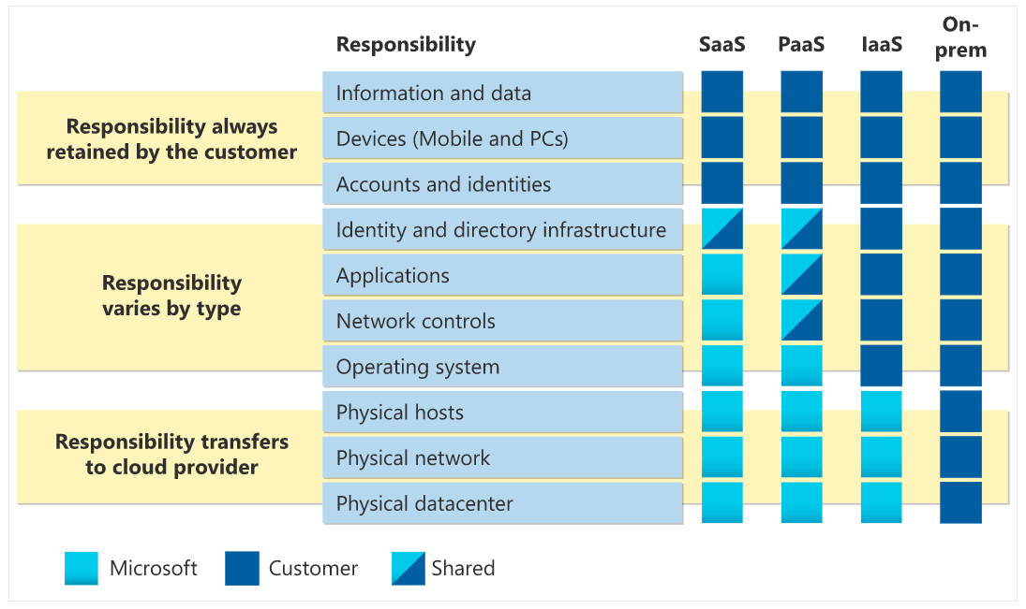
Vendor Customer Shared
Source: https://learn.microsoft.com/en-us/training/modules/describe-cloud-compute/4-describe-shared-responsibility-model
Notes:
The different delivery models also come with different responsibilities. Here you can see that for SaaS, the responsibility for the Information, data, devices, accounts are all the responsibility of the customer whereas the networking, applications and any operations are the responsibility of the vendor. As you move to PaaS, IaaS and finally On-Premise, the customer must take on more responsibilities.
Shared Responsibility Model.
What does Kofax Offer
You’ll always be responsible for:
The information and data stored in the cloud
Devices that are allowed to connect to your cloud (cell phones, computers, and so on)
The accounts and identities of the people, services, and devices within your organization
The cloud provider is always responsible for:
The physical datacenter
The physical network
The physical hosts
Your service model will determine responsibility for things like:
Operating systems
Network controls
Applications
Identity and infrastructure

Slide 10



Choosing the Right Cloud Model?
Data Security, SLAs & Compliance
Migrating into the Cloud
Notes:
Challenges selling cloud
Migration from On-Prem to Cloud
Data Security
Governance
Which Cloud to use?
Choice of vendors –
Avoid lock in

Slide 11
Choosing the Right Cloud Model
Cloud of Choice
Notes:
So what can we offer for customers? Well, we give then CHOICE. They can choose how they consume and run Kofax products and solutions. As we just covered, they have the Option of SaaS or PaaS where Kofax runs and maintains the software.

Slide 12

Cloud of Choice Deployment Options
Kofax Cloud Overview
Virtual Machines
Containers
As-A-Service
App 1
App 1
App 1
App 1
App 1
App 1
Bins/Libs
Bins/Libs
Bins/Libs
Bins/Libs
Bins/Libs
Bins/Libs
Guest OS
Guest OS
Containerization Engine
Kofax Cloud / Partner Cloud
Hypervisor
Host OS
Host OS
Infrastructure/Cloud
Infrastructure/Cloud
Notes:
But there are other options too depending on the product or solution.
Customers can choose to consume the service directly from Kofax or from one of our partners that are hosting and delivering the service.
Many of Kofax products are available for deployment using containerization. This is a way to optimise the use of infrastructure and can help avoid vendor lock-in to a specific hosting provider. This is because the containers can easily be migrated with little dependency on the providers themselves.
Highlight that our Docker strategy specifically enables cloud native deployment, plus allows for “multi-cloud” strategies where clients chose to deploy to more than one public cloud service to avoid vendor lock-in.
For the 5% or so of customers that still have not started adopting cloud, Kofax technologies can still be deployed to physical or virtual environments using hypervisors such as VMWare ESX or Microsoft Hyper-V

Slide 13

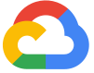

Kofax is Multi-Cloud
Microsoft Azure
Amazon Web Services
Google Cloud Platform
Kofax’s strategic hosting provider
Microsoft 365 integration from TotalAgility, Printix & Power PDF
SharePoint & Dynamics connectors
TotalAgility, RPA & SignDoc containerised deployment
Simple Mail Service
Route 53
TotalAgility, RPA & SignDoc containerised deployment
Kofax Clarity partnership
Google Workspace integration from Printix & Power PDF
TotalAgility, RPA & SignDoc containerised deployment
Notes:
Kofax maintains knowledge, capabilites and relationship with all leading cloud vendors for interoperability and flexibility.

Slide 14



100%
renewable energy by 2025
Water positive by 2030
replenish more water than we consume by 2030
Zero-waste
certification by 2030
Net-zero
deforestation from new construction
Notes:
Also highlight Multi-cloud – AWS, GCP & Azure
Microsoft Azure is Kofax’s strategic hosting partner for the Kofax Cloud, allowing us to minimise our environment impact.
Comply with and support the Modern Slavery Act

Slide 15
Data Security, SLAs & Compliance
Addressing Data Governance Questions

Slide 16
Kofax Cloud Locations
Data Security, SLAs & Compliance
Kofax Cloud Services Support Locations
Kofax Cloud Azure Regions
Kofax Private Cloud (Kofax data centre)
Note: available hosting regions may vary by product. Some services also make use of AWS & GCP.
Notes:
TotalAgility Cloud was launched in 2019 in the US. The service was expanded in 2020 to over EU hosting.
Note we piggyback on Azure’s high level of compliance and security: https://docs.microsoft.com/en-gb/azure/compliance/
Support locations: Hyderabad (first line support / call handling only), NY, Dallas, Irvine, Stockholm, Derry/Londonderry
Azure Locations (Americas): East US, East US 2, Central US, South Central US, West US
Azure Locations (Europe): North Europe (Dublin), West Europe (Amsterdam)
Azure Location (APAC): Southeast Asia, Australia East, Australia SouthEast
Note that we also include the option of using AWS in our DPA as some applications use AWS (not KTA Cloud, which is 100% Azure). For example RSO makes use of AWS Route 53 & Simple Mail Service. Kofax Clarity uses Google (GCP) with configurable option of US or EU data processing.
Private Cloud hosting is in Kofax Data Centres (formerly TIS), primarily in Texas US, but with an option for EU deployment subject to commercials.
Note: SignDoc cloud is only available in Azure Europe North / Europe West.
Support locations: US, Northern Ireland, Sweden, India.
Other locations are available, based on Azure location, if client has specific hosting requirements (& subject to commercial agreement)

Slide 17




Governance, Policies & Procedures for the Kofax Cloud
Data Security, SLAs & Compliance
Cloud Services
Corporate
HR
Governance
Acceptable Use
Access Control
Breach Notification
Business Continuity Plan
Change Management
Cryptographic Controls
Data Management
Firewalls & Network Standards
Incident Response Plan
Information Security
Roles & Responsibilities
Secure Software Development Lifecycle
Vendor Management
Server Hardening
Access Control & Permissions (inc. Physical & General Access)
Backup & Restore
Password Strength
Data Classification & Protection
Data Retention
Disaster Recovery Action Plan
External File Sharing
IT Security Policy
Mobile Use
New Technology
Online Privacy
Storage of Corporate Data
Virtual Machine Protection
Employee Handbook
Recruitment Policy
New Employee Orientation
Code of Ethics
Security & Compliance Certification (renewed annually for all employees)
Contractor Acknowledgement of Compliance
Creating & Maintaining Policies
IT Security Incident Response
Vendor Management
Note: this is a subset of Kofax policies, detailing those most relevant for cloud (excludes engineering policies & others)
Notes:
Kofax has robust governance and operational procedures in place for the Kofax Cloud based on year of experience running our SaaS offerings. All Kofax cloud offerings a run according to the same governance policies.
All policies are reviewed annually, and risk assessments are carried out at least annually or when any material change to the service is planned.
Note that Kofax do not share detailed operational procedures or policies externally.
For more information, see: https://kofaxinc.sharepoint.com/sites/legal/Shared%20Documents/Forms/BCGs.aspx
And: https://kofaxinc.sharepoint.com/sites/products/3ps/Process/Forms/PolicyDefinition.aspx
Talking point: security certifications. We benefit from Azure’s high level of security compliance (https://docs.microsoft.com/en-gb/azure/compliance/).
Kofax is undertaking CIS 20 company wide certification (target end 2021 / early 2022).
Certain Kofax Cloud services are SOC2 compliant (RSO, CloudDocs, iRemit).
ReadSoft Online is Soc2 Type 1 compliant (from April 2021) and should be type 2 compliant by the end of 2021.
SOC2 certification is in the roadmap for KTA.
Note that as all Kofax Cloud services are run according to the same policies and procedures TotalAgility Cloud benefits from the same strict security and compliance measures as the already certified services making it easier for us to certify in the future.

Slide 18
TotalAgility Cloud: Architecture & Experience

Slide 19
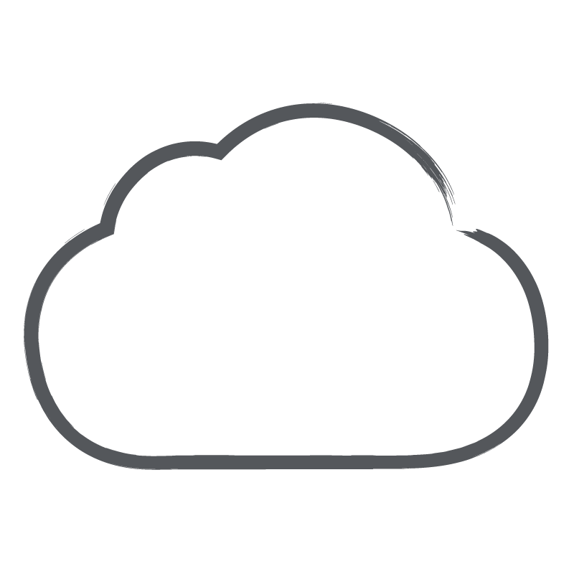
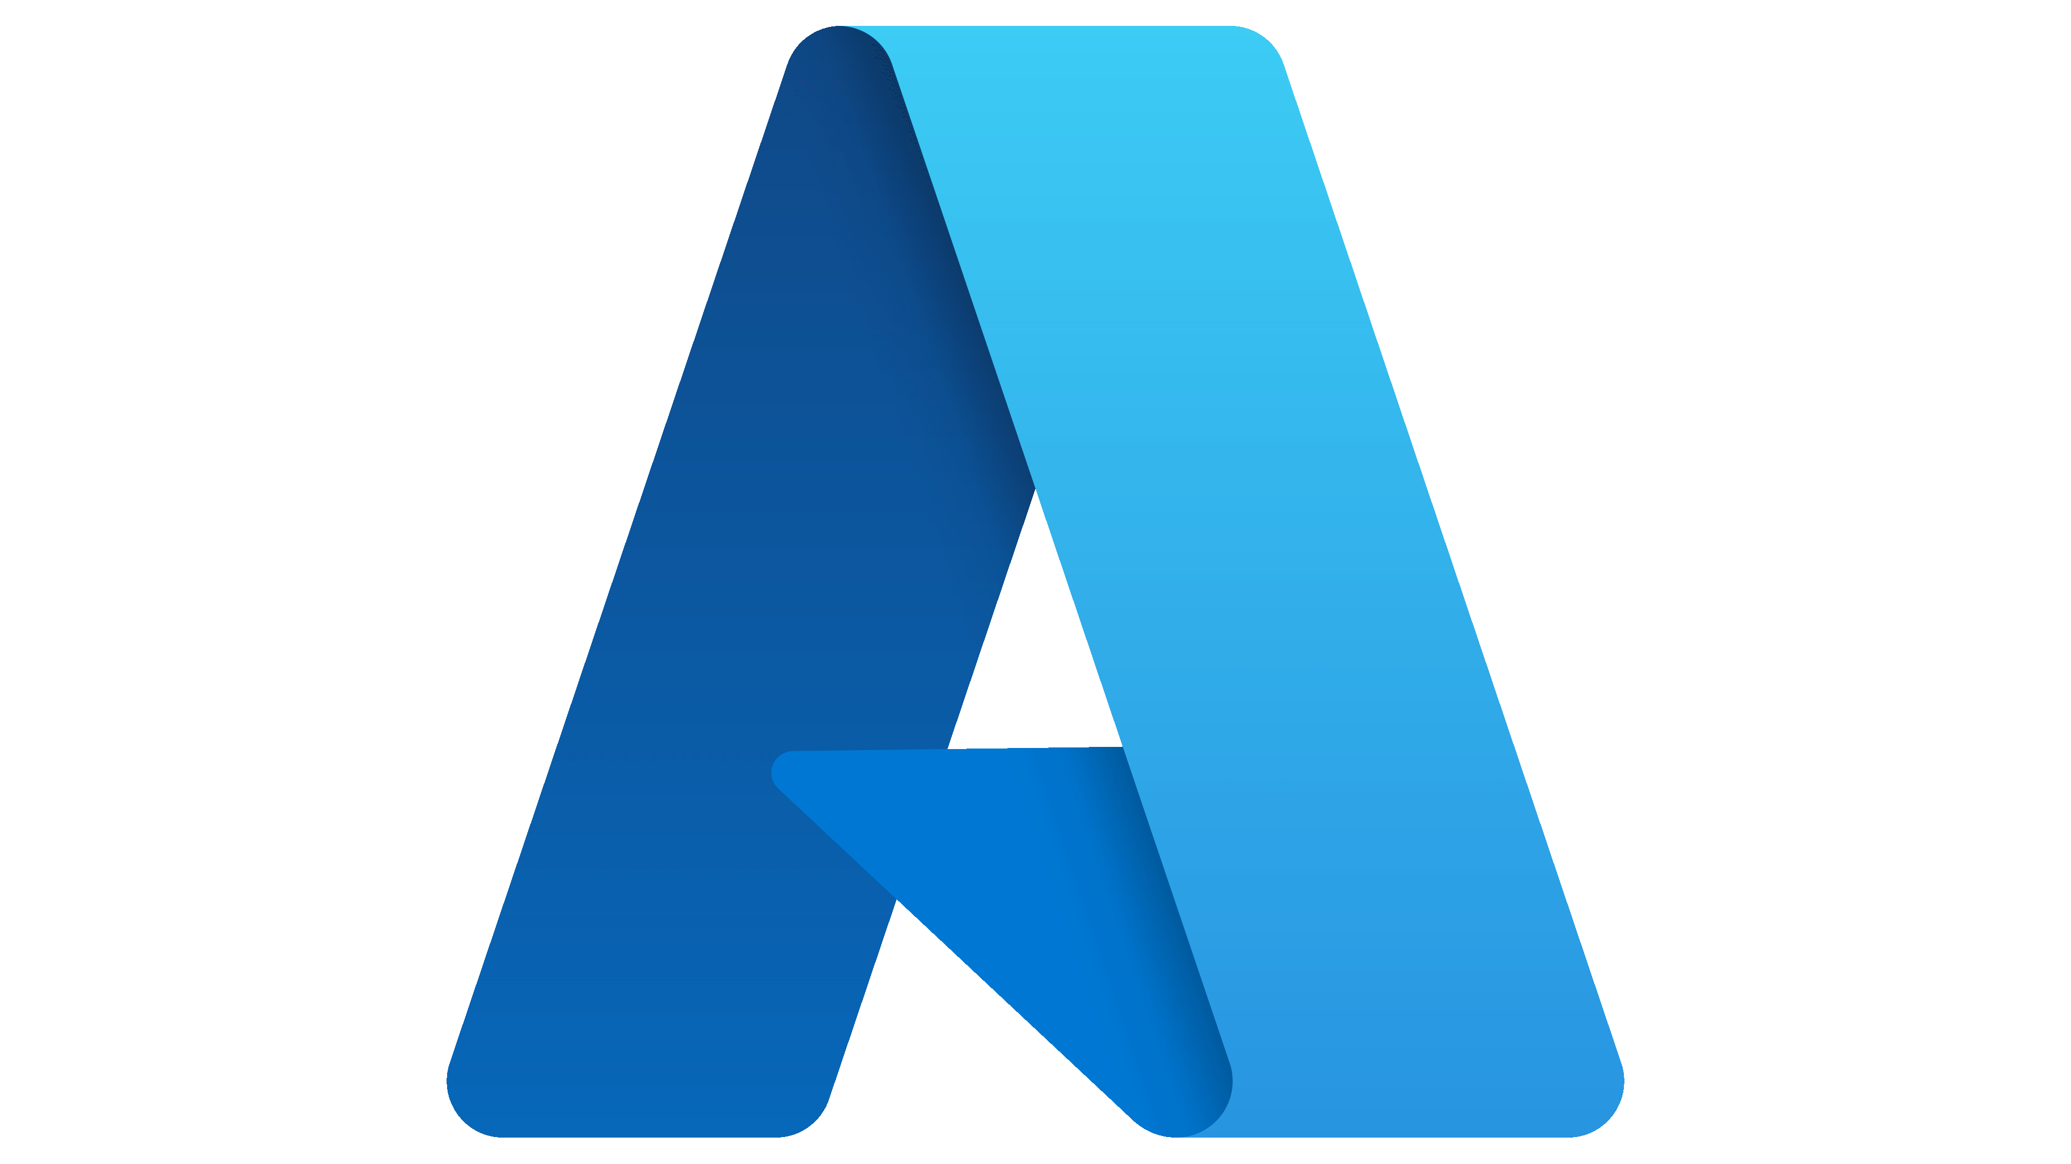
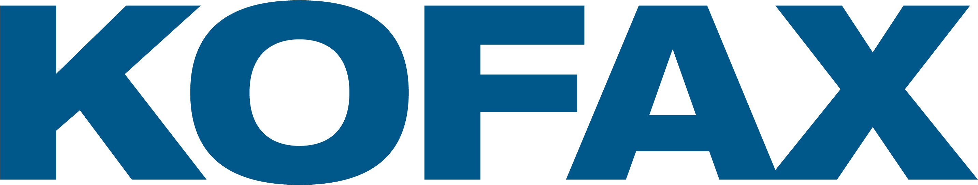



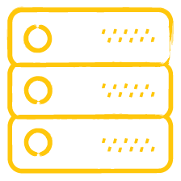

Accessing the Kofax Cloud
TotalAgility Cloud Overview
Kofax Cloud
Client Side Components
Workspace & Designer
(Web Browser, App Store)
Scanners
(Web Capture)
Transformation Designer
(Windows)
Integration Server
(Windows, Docker)
Mobile SDK
(HTML5, Android, iOS)
End user & administrator access via a web portal; Mobile Capture App
Configure & control scan jobs via a web browser
Power user IDE to configure machine learning & data extraction
Optional server to manage on-prem integrations, import & export tasks
Guided document capture integrated into mobile websites & apps
Notes:
Note that in the current release (7.9.0.1) Integration Server is required to import email.
Search & Matching server can also be deployed on premise if needed.

Slide 20
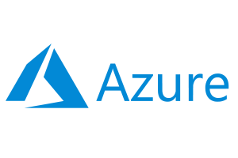
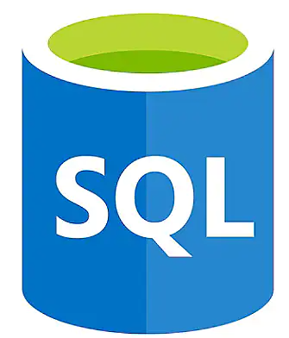
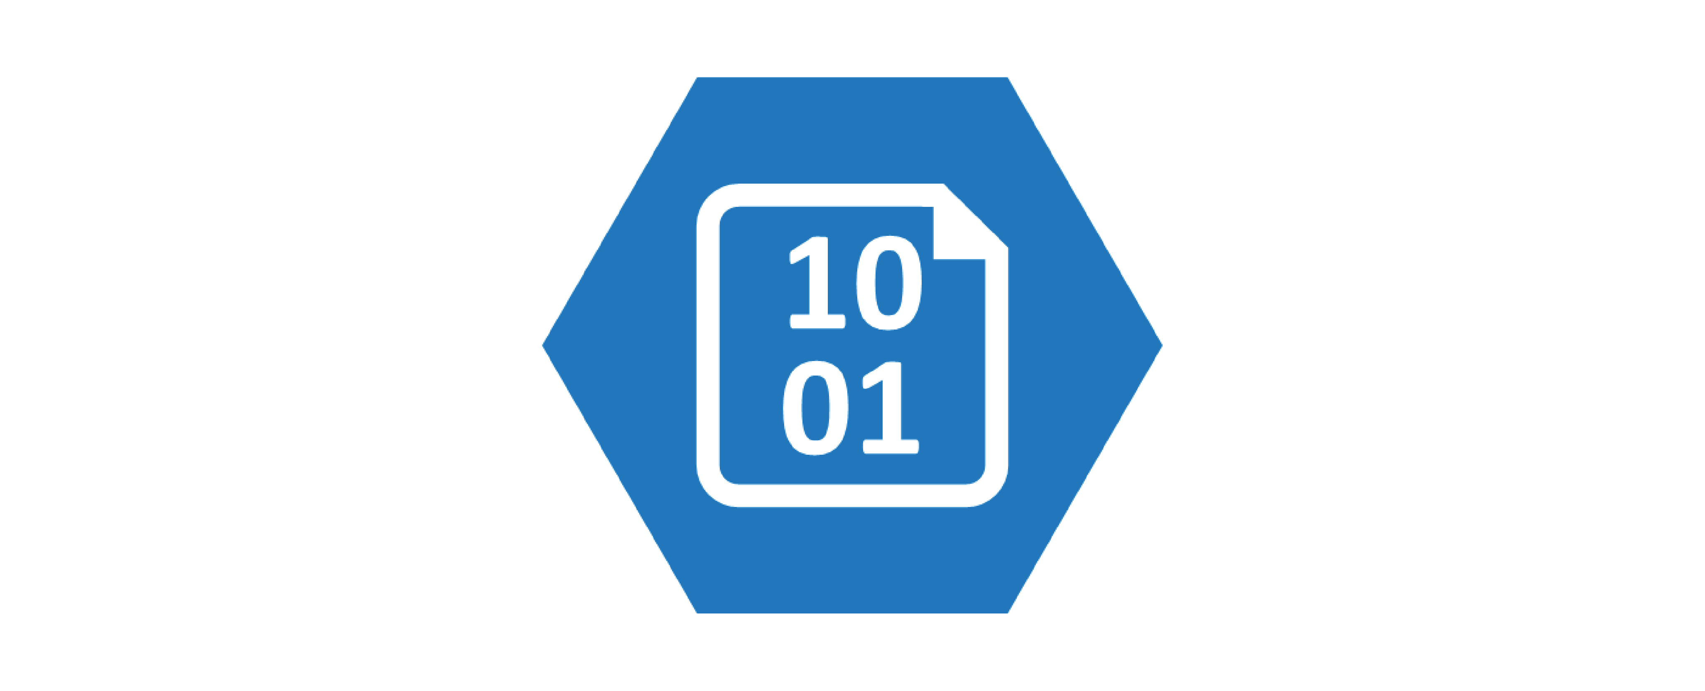
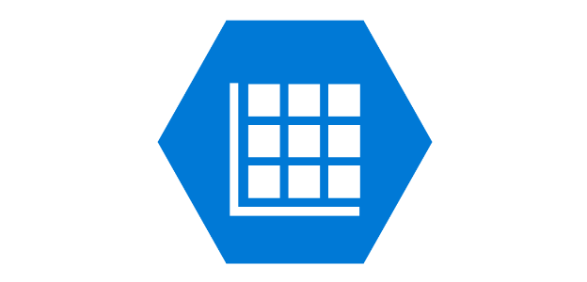
KTA Cloud Architecture
TotalAgility Cloud Service – hosts multiple tenants
Web Role
(multiple instances, at least 2 for SLA)
Transformation Worker Role
(multiple instances, at least 2 for SLA)
Document separation, classification, extraction, image processing for each tenant
Tenant databases and Data Center Tenants database
Multi Tenant IIS Website
Tenant Management IIS Website
Azure Blob Storage
Core Worker Role
(multiple instances, at least 2 for SLA)
Perform automatic activities, monitoring, job archiving & scheduling for each tenant
Reporting Worker Role
(multiple instances, at least 2 for SLA)
Transforms reporting data from Reporting Staging DB schema to Main DB schema for each tenant
Azure Table Storage

Slide 21






Complimentary Kofax Cloud Modules
TotalAgility Cloud Overview
.
Insight
Mobile Capture *
ID Verification * **
Process intelligence, data visualisation & analytics
SDK to develop app & HTML5 capture experiences
Forensic analysis of ID documents & liveness tests inc. facial recognition
.
.
Clarity **
SignDoc
RPA ***
Highly accurate hand writing extraction & image classification
Secure & convenient paperless eSignatures
Complex integration needs inc. web scraping & legacy
* Typically deployed using “Real Time” service level for Kofax Cloud. ** 3rd party data processing (US or EU). *** Self-host only.
Notes:
Note where use 3rd party components.
Infrastructure requirements vary by use case & deployment scenario.
All options available in the Kofax Cloud except RPA which is self-host only.
Worth mentioning RPA of Choice & our support for AA, BP, MS Power Automate / Flow, UiPath.

Slide 22
Key Differences to Self-Hosted TotalAgility
TotalAgility Cloud Overview
SDK, API calls & DLLs
Referenced DLLs must be merged into a single DLL & signed
.NET assemblies run in a non-trusted sandbox
Calling the TotalAgility SDK API from custom .NET assemblies executed through .NET activities or .NET form actions is not supported
Use the Web Services API instead of the TotalAgility SDK
You can directly call the TotalAgility SDK API from the .NET activities or .NET actions (in a business process)
Integration Server
For on-premise line of business applications that integrate via connectors as opposed to the API
For message connector import / export tasks (email protocols, fax, file system…)
Search & Matching Server option for large volume, fuzzy, data searches at remote sites
No database access or file system access
Only the Kofax Cloud Services team have system level access
Notes:
On-premise connectors for system of records such as a database, IBM/FileNet, EMC/Documentation, SharePoint (on-prem) – the export connector is configured to handle specific document types for these systems.
Active import sources include: • Simple Mail Transfer Protocol (SMTP) • Fax Over Internet Protocol (FoIP)
Note that database connectors, CMIS and SharePoint are supported natively on TotalAgility Cloud.

Slide 23
Service Level Agreement Example: TotalAgility Cloud
Data Security, SLAs & Compliance
Kofax Cloud service status is shared here: https://status.kofaxcloud.com/
Default SLAs commitments for TotalAgility Cloud:
99% uptime (can go to 99.9% with no cost)
1hr Recovery Point Objective (worst case loss of data)
8hr Recovery Time Objective (to restore data)
Data is backed up locally and replicated daily, each backup is retained for at least 14 days
Specific SLA commitments will be detailed in the subscription contract
Higher SLA, RPO & RTO service levels can be provided if required, subject to commercials agreement
“Real Time Transformation Service” available as a deployment option for use cases requiring fast extraction & responses
Data Processing/Residency Locations for TotalAgility Cloud in the EU
Primary: Azure Europe North (Ireland)
Backup: Azure Europe West (Netherlands)
3rd party processors: Salesforce (stores support case data), Loggly / Solarwinds (log file analysis), Google (if using Kofax Clarity)
10TB storage is assigned per tenant (can be increased if required, subject to commercials agreement)
All data is encrypted at rest & in transit
Log data retained for 1yr 45 days
All configuration, data & backups purged/removed within 90days of terminating a contract in accordance with GDPR guidelines
In dedicated tenant & database (i.e. no commingling of end client data)
TotalAgility Cloud each client has a dedicated database, storage area & running instances of TotalAgility
Notes:
The Kofax Disaster recovery procedures follow industry standards, and contain periodic risk assessments, integrity checking and review of backup procedures. Kofax’s Subscription Services availability commitment is to provide customers access the platform 99% of the time, no loss of more than 1 hour’s data (Recovery Point Objective or RPO) & with a Recovery Time Objective (RTO) of 8 hrs. Specific SLA commitments will be detailed in the customer’s contract, with details of how data is secured and processed to be found in the Data Processing Addendum.
Higher SLA, Recovery Point Objective (RPO) & RTO service levels can be guaranteed, for additional cost, if required.
Internal notes:
Note: in reality the 99.9% target is usually achieved for KTA Cloud.
Note: active DR site for KTA Cloud would increase the cost by 80-90%.
NOTE: RSO also makes use of AWS and has different SLA commitments and region support.

Slide 24
Version Upgrades
TotalAgility Cloud Overview
The TotalAgility Cloud uses the same software versions as self-hosted versions
The core code base for both TotalAgility Cloud & self-hosted TotalAgility are the same
TotalAgility has a major release approximately every 6-12 months
Runtime packaging, deployment & tenant management is custom for TotalAgility Cloud *
TotalAgility Cloud upgrades typically take place 6-8 weeks after a new version is released
This allows for additional testing before upgrades are rolled out to clients
The standardised nature of the cloud environment ensures upgrades are seamless for clients
Customers are notified at least 36hours in advance of any scheduled maintenance**
The upgrade of all cloud components is managed by the Cloud Services team
Clients will be informed of any required changes to client-side components
Customers who select the “Dedicated Instance” option run on dedicated Azure infrastructure
One benefit of this is clients have greater control over the maintenance & upgrade schedule
* TotalAgility Cloud makes use of Azure Web Services, Blob Storage & other cloud native features
** For major version updates, 14 days notice is provided
Notes:
Our KTA SaaS offering is Microsoft Azure based, so we are subject to its refresh cycle. All Kofax software is kept up-to-date with our own release cycles, sub-releases and patches. All customers are given notification of any such activity

Slide 25
Migrating into the Cloud
Kofax Professional Services

Slide 26
Packaged Consultancy Offerings Planning a move to Kofax TotalAgility
Kofax Cloud Overview
Current State Analysis
Requirements & Dependency Evaluation
High Level Migration Plan
Provide a high-level analysis of the current Kofax solution deployment
Perform a high-level evaluation of dependencies and required move activities
Prepare a high-level migration plan for the move outlining customer and Kofax responsibilities
Package available for customers moving from:
Kofax TotalAgility on premise to Kofax TotalAgility Cloud
Kofax Capture / Transformation to Kofax TotalAgility on-premise / Cloud
eFlow to Kofax TotalAgility on-premise / Cloud
5-day assessment activity
Actual execution of the move requires a dedicated PS engagement.

Slide 27
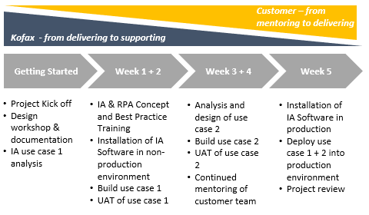
5-Week Enablement Program
Kofax Cloud Overview
Business Challenge(s) Addressed:
Enable customer resources to identify good candidates for IA use cases
Basic training on automation concepts
Practical hands-on guidance
Deliver initial IA solution with Kofax Expert guidance
Empower customer delivery teams to
Scale up intelligent automation activities
Reach level of self-sufficiency
Purpose:
Help customers to reach a point of self-sufficiency with Kofax IA implementations using a rapid transitioning approach
Assist during design and implementation of initial IA use cases
Program Features:
Architectural lead design workshop
Design and implementation of initial IA use cases driven by Kofax with Customer shadowing
Best practice consultancy for design, test, build and deployment of initial IA processes
Customer´s involvement increases in subsequent delivery of automation use cases with Kofax supporting
Assistance on identifying good IA candidates
Training on IA Concepts
Arrangement:
Following initial design phase, Kofax to provide support over 5 weeks where engagement is reduced over time from driving delivery to a more supportive role
Notes:
Kofax PS have a 5 week “Enablement” program that we suggest for any new customer be it that they have chosen self-hosted or Kofax cloud. This program is really designed to help the customer be as self sufficient as possible.
The program was built with a view to having the customer shadowing Kofax and learning as they go.
As you would expect, the program covers everything that is required to design, implement, train and operate the solution. It also helps the customer understand what use cases are good candidates for implementation within Kofax.
All in all, this should cover everything the customer needs to be successful in implementing and growing the use of TotalAgility within their organisation.
Whilst this was designed for TotalAgility, it covers other parts of the IA platform too such as RPA so they can get the most from their investment and start seeing the ROIs that they expect within a much shorter timeframe than if they “go it alone”

Slide 28
Summary & Next Steps
Kofax Cloud Overview

Slide 29


It’s just Cloud
Don’t be
Afraid
Customers Want it
Preferred or Only option
Image by Robin Higgins from Pixabay
Notes:
Customers are already adopting cloud as the de-facto standard for all technology acquisition. They want cloud and indeed, many customers we hear from are shifting further than we expected and are moving from “Cloud First” to “Only Cloud”!
Whilst we recognise the shift in desires are there, we need to be cognisant of some challenges that this represents, not just for Kofax & our partners, but for our customers too. Our customers own procurement processes are frequently lagging behind, having been built and honed by years of purchasing perpetual software. This can lead to slowing down of some sales cycles, to address this, we need to ensure customers understand the reasons their business is making the transition.

Slide 30

SaaS Trade off
It must be
Easy!
Simplicity
Control
Image by Robin Higgins from Pixabay
Notes:
When adopting SaaS or PaaS, customers must trade off some of the control they have over setup for simple configuration capabilities. This trade-off should be communicated up-front with prospects that

Slide 31

Customer Satisfaction
Is key to Success
Image by Robin Higgins from Pixabay
Notes:
If we don’t have happy customers on a SaaS or term model, they simply will not renew the agreement for another term. Without the renewal, we are all going to loose out! To minimise the impact and also to ensure customers

Slide 32
Resources & Support
InfoSec Primer documents:
TotalAgility Cloud
AP Essentials
Support & InfoSec responses:
cloud-help@kofax.com

Slide 34
Integration Server Import Connectors
TotalAgility Cloud Overview
Active import sources (run as services within TotalAgility) include:
Simple Mail Transfer Protocol (SMTP)
Fax Over Internet Protocol (FoIP)
Passive import sources (poll external resources) settings include:
Post Office Protocol (POP3)
Internet Message Access Protocol (IMAP)
MS-Graph
Exchange Web Services (EWS)
External Fax Server
File
Automatically convert incoming messages into documents for natively handling
Notes:
You can configure TotalAgility to receive documents through POP3, IMAP, SMTP, MS Graph, fax servers, folder and Exchange Web Services. Each external system has configuration settings that create TotalAgility processes when business documents are received.

Slide 35
Integration Server Connectors
TotalAgility Cloud Overview
Integration Server Export Connectors
TotalAgility Cloud Native Integrations
Box
Database (on-premise)
Dynamics AX
Dynamics CRM
EMC/Documentum
Email
Exchange
Fax
File System
IBM/FileNet
Linked TotalAgility Servers (on-premise)
Micro Focus Content Manager
OpenText
Pega Rules Process Commander
SAP
SharePoint (on-premise)
.NET
CMIS
ControlSuite
Database
Insight
Kofax Communications Manager
Linked TotalAgility Servers (internet accessible)
OAuth2.0 servers
RPA
SignDoc
SharePoint (online)
SMTP (email notifications)
Web Services (SOAP / REST / OpenAPI / Oauth)
Notes:
https://knowledge.kofax.com/Capture/Product_Documentation-User_Guides/Kofax_Export_Connector_Product_Documentation

Slide 36

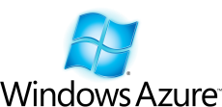
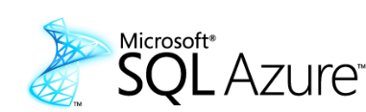
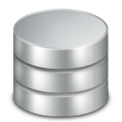





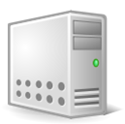


KTA – Azure Data Center - Architecture Overview
TotalAgility “Live” Azure Cloud Service
- hosts multiple tenants for “Live” deployment
SQL Azure Tenant Databases
(one database per Tenant, with separate Live, Dev and Reporting schemas)
Azure Web Role
(1 role, multiple instances, at least 2 for SLA)
HTTPs
Azure Worker Roles
(3 roles, multiple instances, at least 2 per role for SLA)
SQL Azure Data Center Tenants Database
(stores Tenant configuration data, connection strings for Data Center)
Process/Form Designer, Forms Workspace,
Transformation Designer
Analytics Tenant VMs
TotalAgility “Dev” Azure Cloud Service
- hosts multiple tenants for “Dev” deployment
HTTPs
Azure Storage
Azure Web Role
(1 role, multiple instances, at least 2 for SLA)
Table Storage
(stores diagnostic and Reporting data)
KSMS Server
- hosted by customers OnPremise
Azure Worker Roles
(3 roles, multiple instances, at least 2 per role for SLA)
Blob Storage
(stores Document data)
Notes:
TotalAgility Cloud – detailed technical architecture

